Slide 1

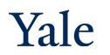
Deep Learning Theory and Applications Graph Neural Networks
CPSC/AMTH 663
CPSC 452

Slide 2
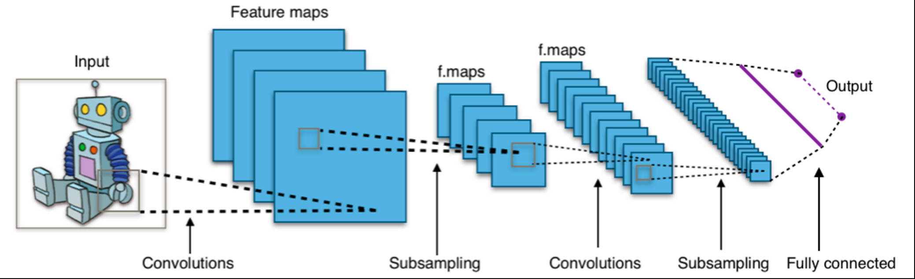
Recall CNNs
Design to account for image structure

Slide 3
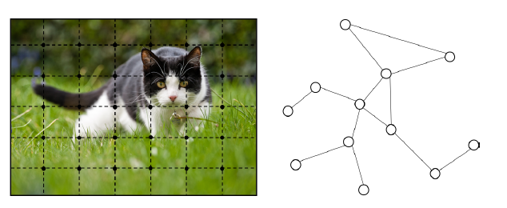
Images are a specific sort of graph—grid graph

Slide 4
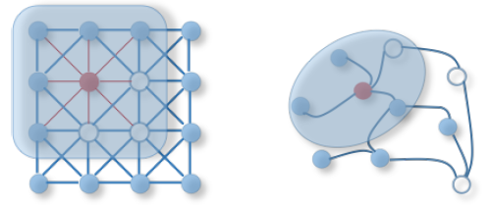
More general graph structures

Slide 5
Recall: CNNs use three basic ideas
Local receptive fields
Problem: There is no clearly defined direction or method of translation over a graph (cannot cleanly slide a convolution)
Shared weights
Pooling

Slide 6
How can we approximate these on more general non-grid graphs
Spatial construction (Bruna, Hamilton)
Apply the same operator and move over the graph space in some fashion
Notion of locality based on neighbors of a node
Spectral construction (Bruna, Defferard)
Define a convolutional operation in the graph spectral space
Uses signal processing theory to define filters in the graph Fourier domain
Notion of locality based on global properties of the filter

Slide 7
Spatial Construction

Slide 8

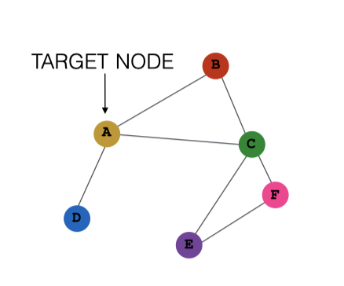
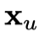
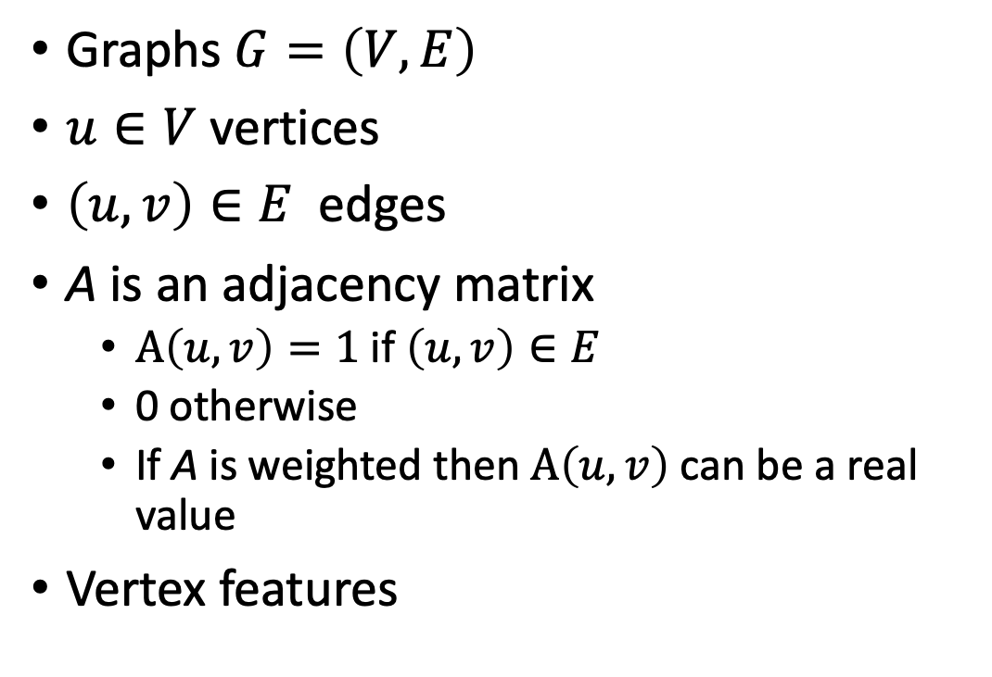
Graph Notation
Graphs $G=\left(V,E\right)$
$u∈V$vertices
$\left(u,v\right)∈E$ edges
A is an adjacency matrix
$A\left(u,v\right)=1$if $\left(u,v\right)∈E$
0 otherwise
If A is weighted then $A\left(u,v\right)$ can be a real value
Vertex features

Slide 9
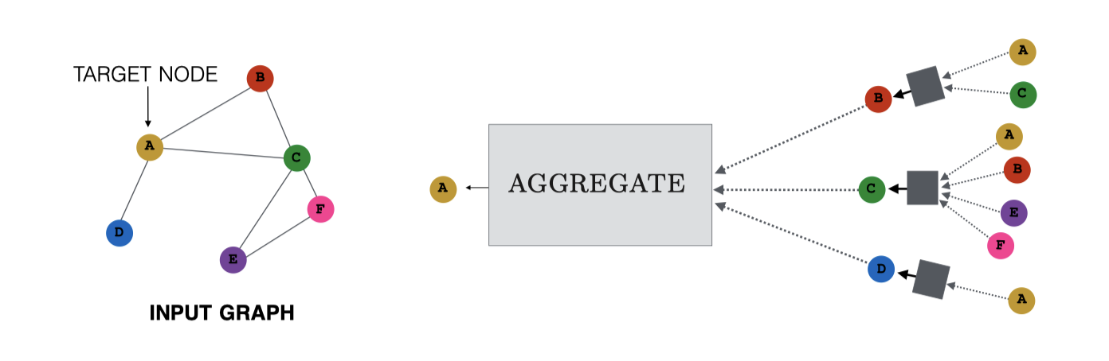
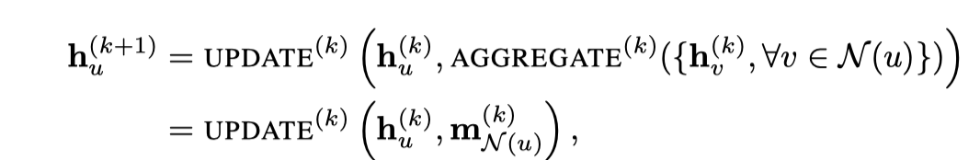
Message passing

Slide 10
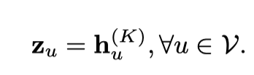
Message passing iterations
There can be several iterations of message passing through a GNN
At each iteration, the message from the previous iteration is aggregated through neighboring vertices
After k iterations you get a latent embedding of node u

Slide 11
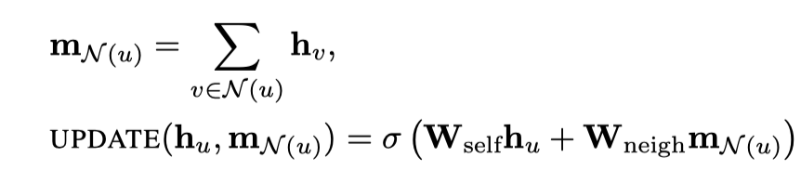
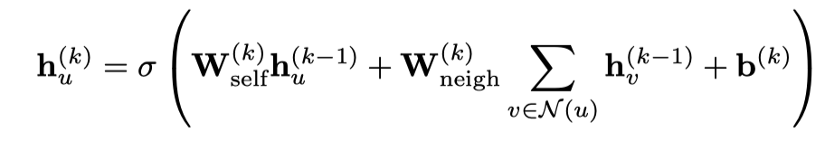
Aggregation, Updating
W are trainable parameter matrices

Slide 12
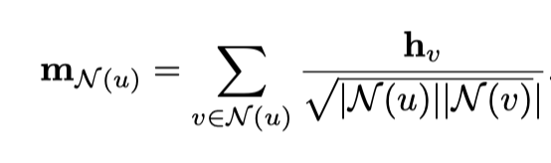
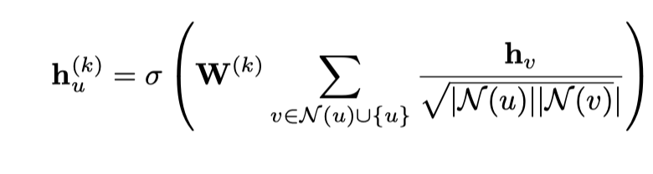
Normalized Aggregation
Normalize by number of vertices in each neighborhood
Normalized message passing in the GCN

Slide 13
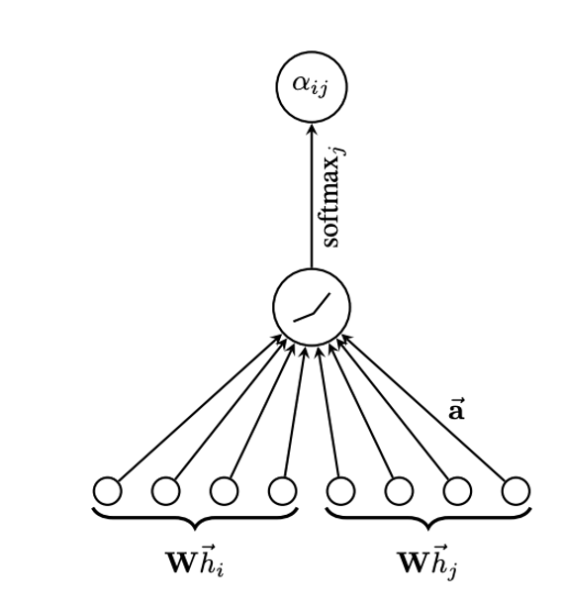
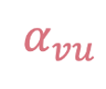
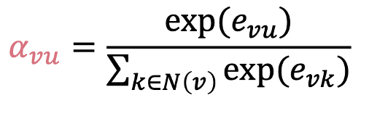
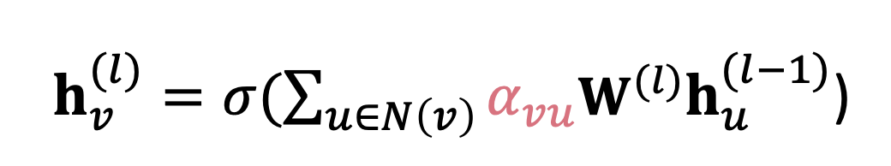
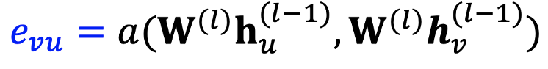
Graph Attention

Slide 14
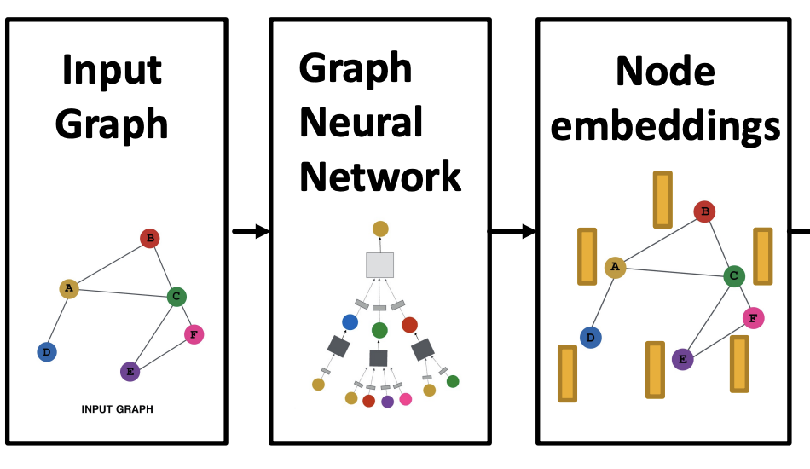
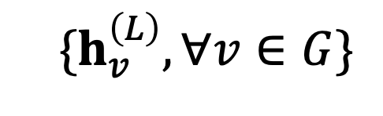
Training GNNs to do tasks
Node level tasks
Edge level tasks
Graph level tasks

Slide 15
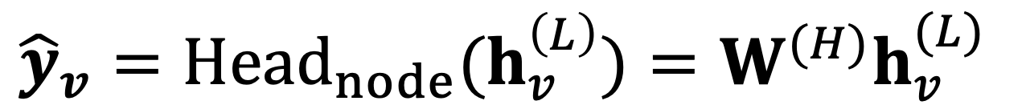
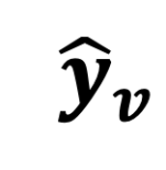
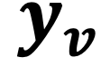
Node level tasks
Node classification/regression
Map node embeddings directly via node head to prediction
Loss= ||
-
||₂

Slide 16
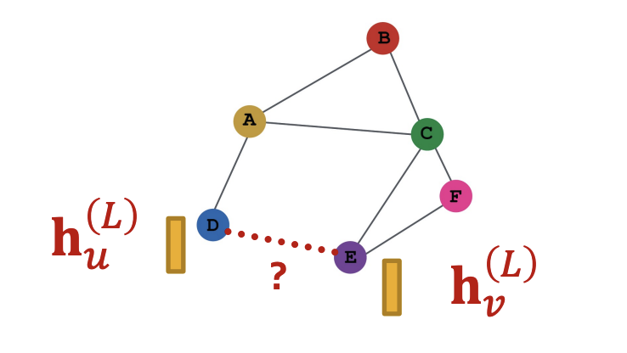
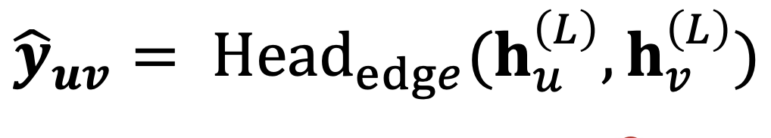
Edge level tasks
Examples: missing link prediction
Edge weight/strength prediction

Slide 17
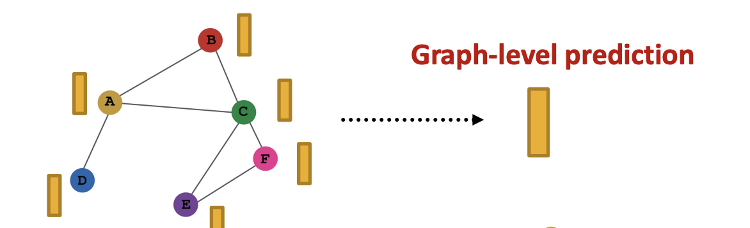
Graph Level Tasks
Graph classification (does this graph have a 5-clique?)
Graph regression (does the molecule this graph encodes bind to a virus?)

Slide 18
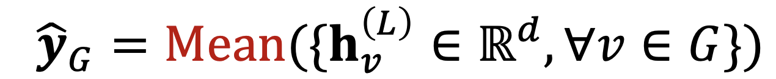
Graph level pooling
Mean pooling
Can also have max pooling, sum pooling
But pooling can result in a loss of information

Slide 19
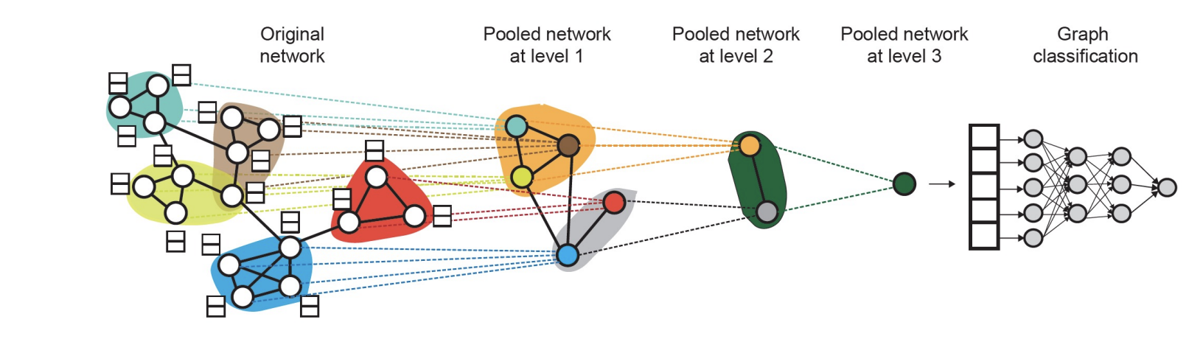
DiffPool

Slide 20
Prop 1: Permutation equivariance
Graph and node representations are the same regardless of how nodes are ordered in the adjacency matrix
This is achieved via permutation equivariant aggregation operations
Mean
Sum
Max

Slide 21
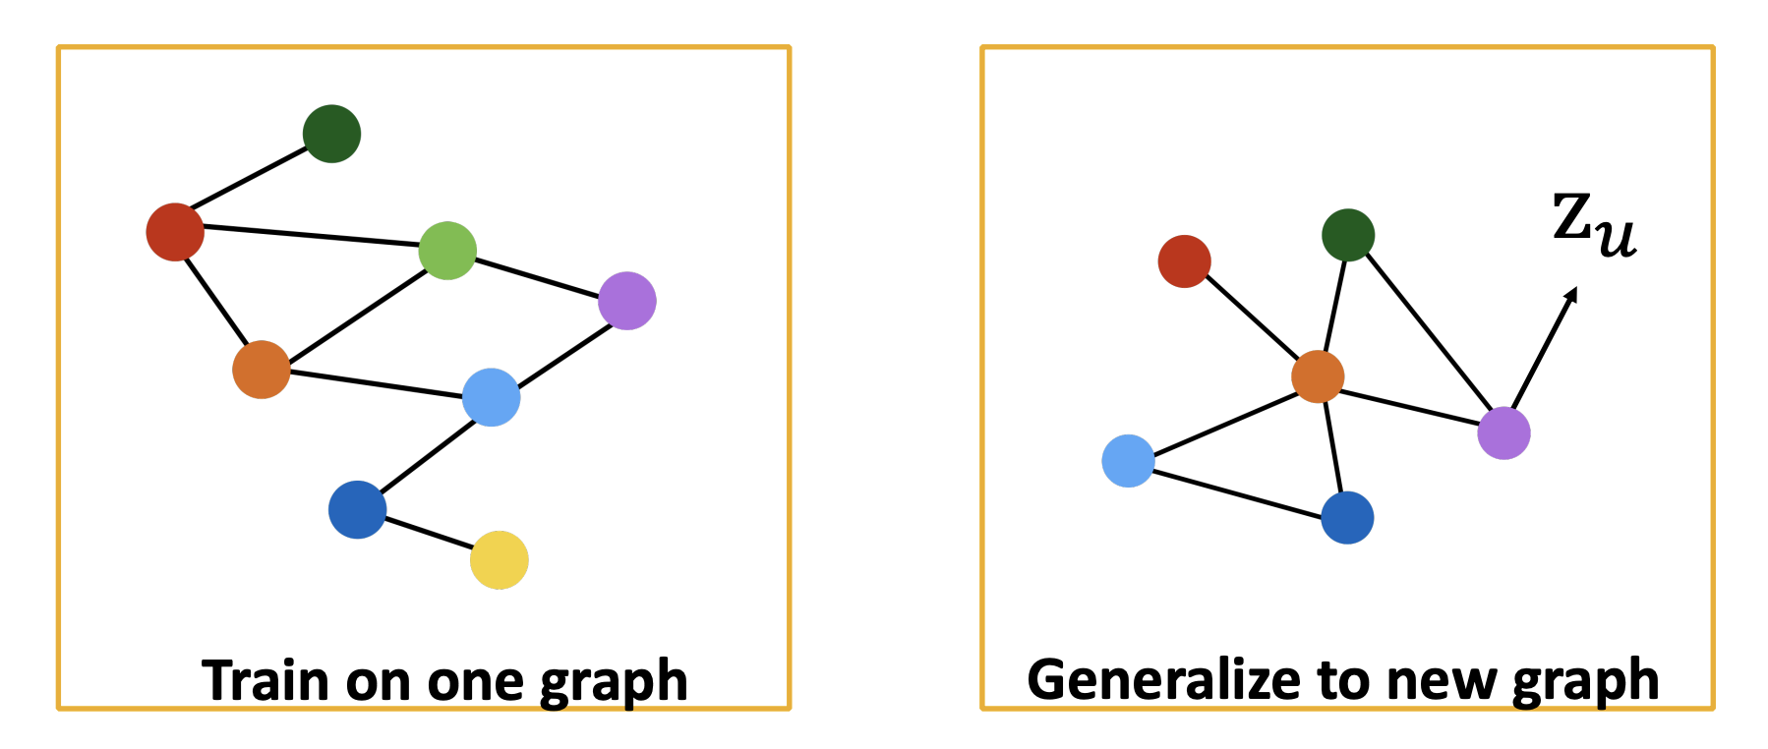
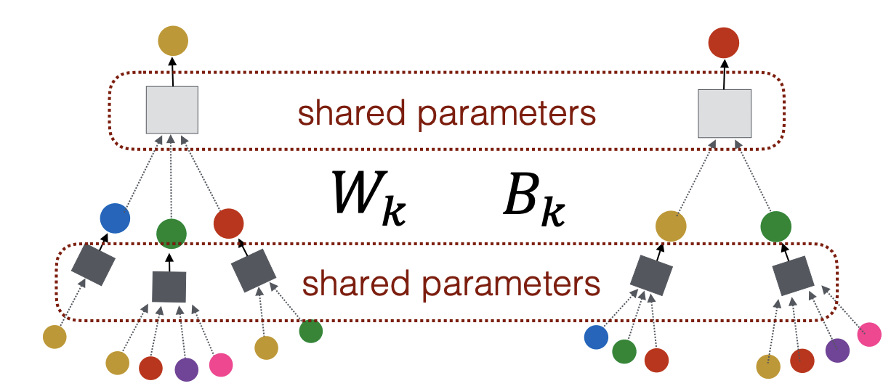
Prop 2: Inductive capability
This is achieved by sharing weights across all nodes

Slide 22
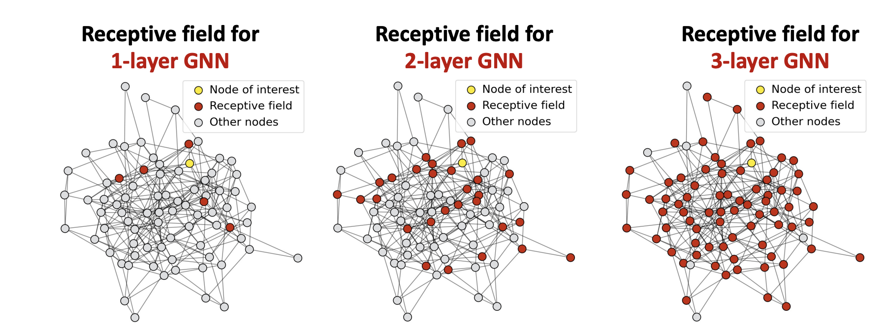
Limitations of GNNs
Message passing can lead to oversmoothing!

Slide 23
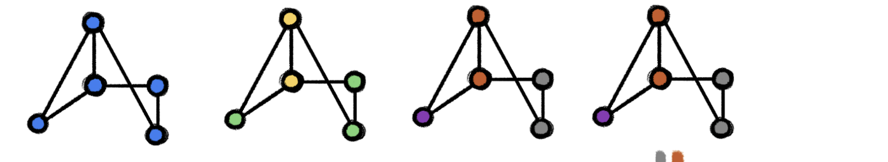
Weisfeler-Lehman Test of Isomorphism
Start with all nodes of the same color (same node label “0”)
Aggregates color of a node with its neighbors (“00” or “000”)
Hashes aggregated colors into new label (“00”=1 ”000” = 2)
Aggregates new labels (“12” or “21”)
Repeats hashing
Stops when coloring is stable
If at that point two graphs are differently colored they are non-isomorphic

Slide 24
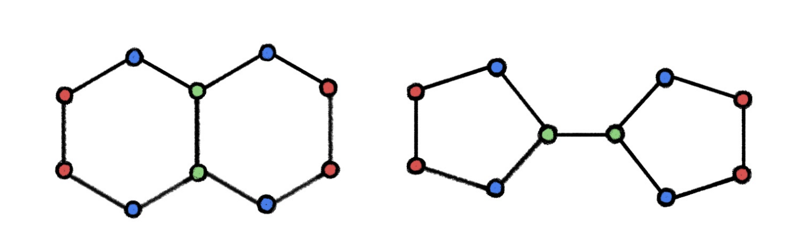
W-L Test Test results in false positives
These graphs are colored the same but are not isomorphic!

Slide 25
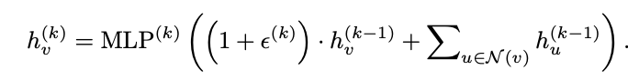
GNNs are AT MOST as powerful as WL
In a GNN that uses message passing, each node aggregates neighbor features
Thus it is very similar to its neighbors
But choice of aggregation function important in giving as much power as WL algorithm
Most popular aggregators (mean, sum) are less powerful than WL!
Xu et al. proposed an aggregation function that makes it equivalent to WL

Slide 26
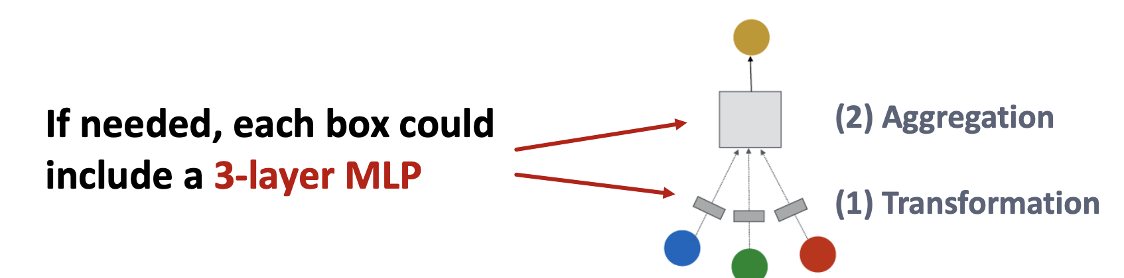
Solution 1
Don’t just add layers to GNNs (message passing iterations)
Increase power within an aggregation

Slide 27
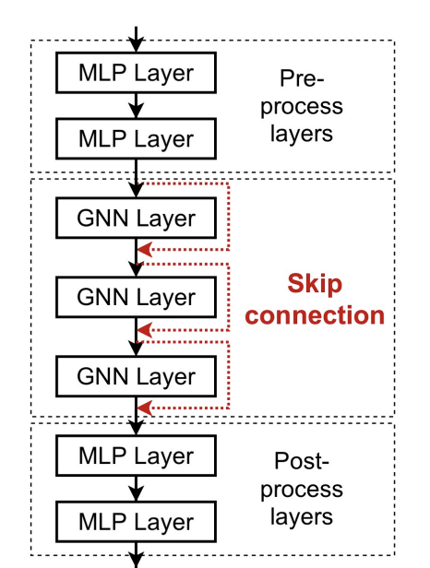
Solution 2
Add Skip connections !

Slide 28
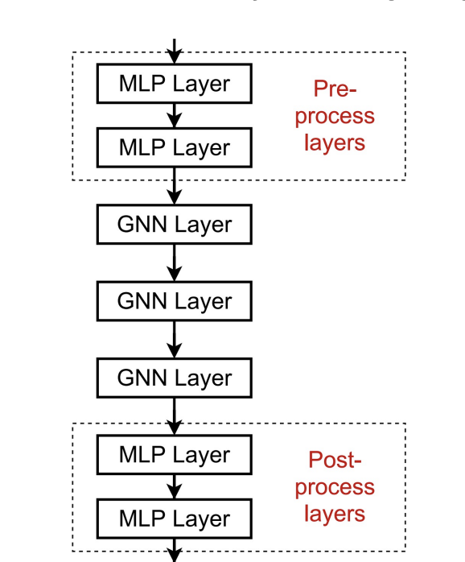
Solution 3
Add fully connected layers!

Slide 29
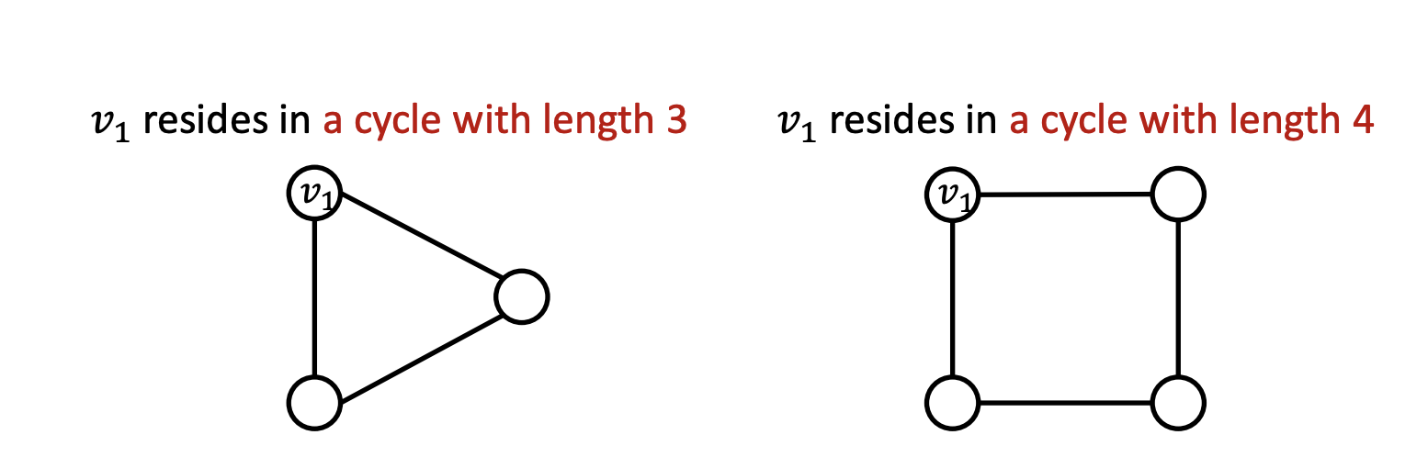
Feature augmentation/engineering
Can add features to make GNNs more expressive
Local aggregation won’t distinguish these but can add vertex features
Cycle count, Node degree, Edge degree, Node centrality, anything from graph theory!
Unique identities to nodes

Slide 30
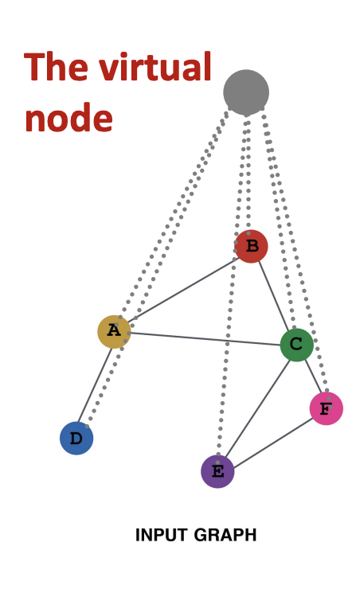
Graph augmentation/engineering
Graph can be too sparse
Too dense
Not connected enough
Can add virtual nodes and edges to the graph!
Subsample or cluster nodes for the graph

Slide 31
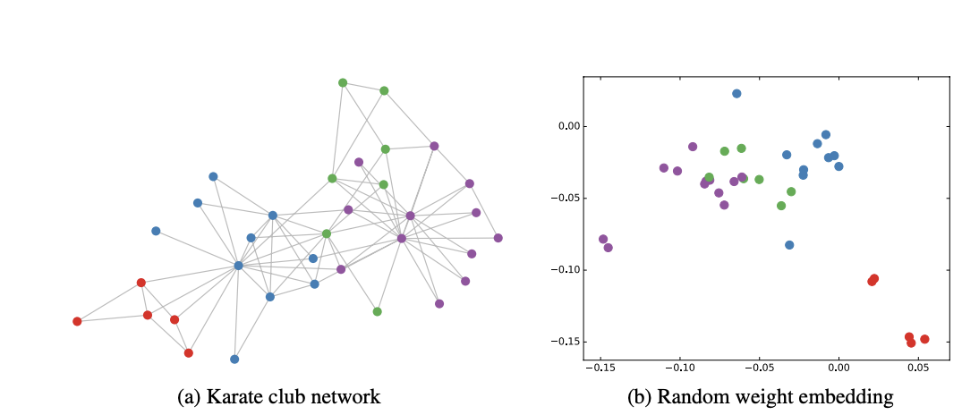
Node Embeddings
Original Graph
GCN Embedding

Slide 32
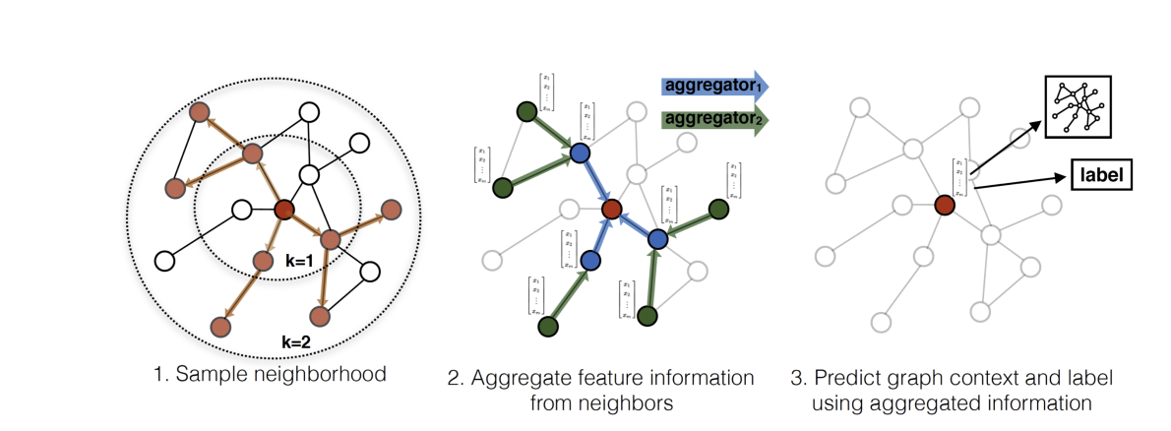

GraphSAGE
Inductive, message passing network
Mean aggregation –aggregates neighbors and concatenates self (skip)
LSTM Aggregation – visit nodes in random order to perform aggregation

Slide 33
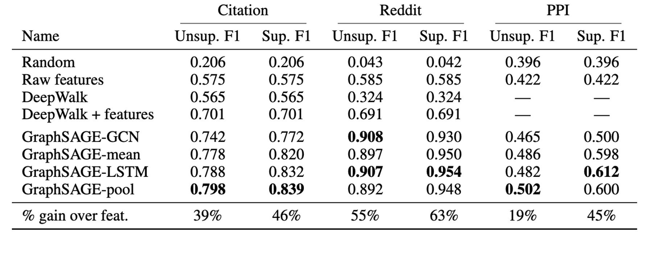
Node classification results from Graph SAGE

Slide 34
Reading list
Hamilton et al. Inductive Representation Learning on Large Graphs
https://towardsdatascience.com/expressive-power-of-graph-neural-networks-and-the-weisefeiler-lehman-test-b883db3c7c49
Hamilton Book chapter 5
https://arxiv.org/pdf/1810.00826.pdf
https://arxiv.org/pdf/1609.02907.pdf

